Slide 2
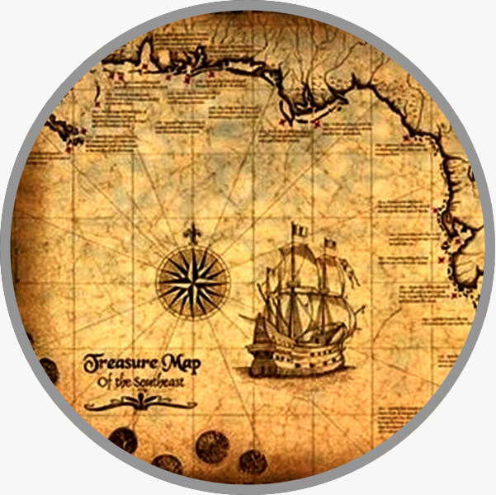
Sermon on the Mount
Matthew 5-7
“The Lord’s Treasure Map”

Slide 3
Sermon
on
the Mount
Matthew 6:16-21
FASTING: vs. 16-18
Verse 17 is the KEY – “anoint your head and wash your face,”
Don’t try to look your worst!
  Don’t make a play for sympathy!
  Fasting is a personal thing.
  Not to punish yourself to make you a greater saint

Slide 4
True And Lasting Treasure Is Found Verses 19-21

Slide 5
Sermon
on
the Mount
Matthew 6:19-21
TREASURE NOT ON EARTH: vs. 19
Luke 12:16-21 “FOOL!” “Unwise, inconsiderate, simple, senseless…Implied is the charge that they do not truly know God.”
James 5:1-3 “their corrosion will be witness”
EARTHLY TREASURE HAS A WAY OF DRAWING ONES HEART FROM GOD 1 Timothy 6:8-10
Luke 18:18-24

Slide 6
Sermon
on
the Mount
Matthew 6:19-21
THE LORD’S TREASURE IS PERMANENT
  Luke 12:31-34 “a treasure in the heavens”
IT IS ETERNAL TREASURE Matthew 6:20
  Valuable Treasure – Matthew 13:44
  Hebrews 11:23-26
  Worth All The World! Matthew 16:26
  Matthew 19:21- Turn AWAY from the LOVE OF THE WORLD and from following the DEVIL’S MAP!
  1 Peter 1:3-5 –”an inheritance incorruptible”
  Matthew 19:21,24, 29

Slide 7
Sermon
on
the Mount
Matthew 6:19-21
TWO TREASURES DETERMINED BY TWO HEARTS
  Seek The Treasure Of The World
  Trust In Uncertain Riches – 1 Timothy 6:17
  Seek The Treasures of Christ
  Hearts fill of JOY, HAPPINESS and HOPE!
  Romans 14:17
  Galatians 5:22,23

Slide 8
Sermon
on
the Mount
Matthew 6:19-21
GREATEST TREASURE OF LIFE IS THE POSSESSION OF JESUS IN YOUR HEART
  Hebrews 13:5 “I will never leave you nor forsake you.”
  Ephesians 3:17-19 “that Christ may dwell in your hearts through faith”
  Secret to greatest treasure is HOW you posses your own heart

Slide 9
Sermon
on
the Mount
Matthew 6:19-21
JESUS WAS CONCERNED HIS FOLLOWERS MIGHT LOSE THE TREASURE BY BEING ENTICED TO THE WORLDLY TREASURE
1 Corinthians 10:12 “take heed lest he fall”
Hebrews 3:12-15 “lest there be in any of you an evil heart of unbelief in departing from the living God;”

